Slide 1



Unraveling Trends and Insights
by Shirley Nakalema
Notes:
Title: "Analyzing Netflix Content: Unraveling Trends and Insights"

Slide 2

Objectives
Explore and gain insights into the Netflix content library.
Understand the distribution of movies and TV shows.
Identify patterns in content availability across different countries and years.
Notes:
The objective of this analysis is to…………

Slide 3

Dataset Overview
Information in the dataset
type
title
country
duration
release year
content rating
Notes:
This dataset contains information about Netflix movies and TV shows,
including the type (movie or TV show), title, country of production, duration, release year, and content rating.

Slide 4
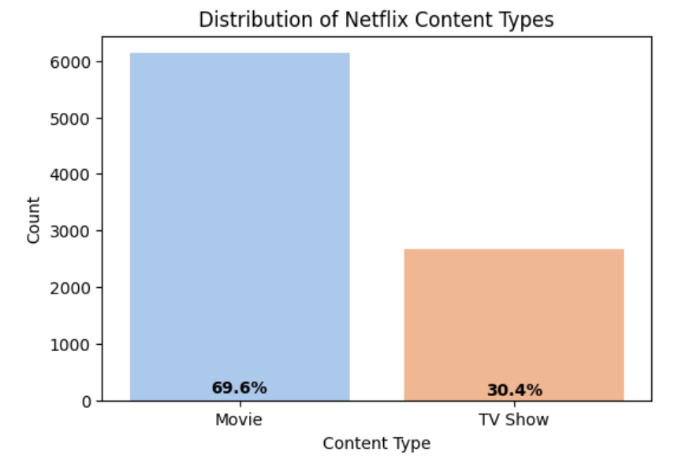
Netflix Content Types
Content types on Netflix.
Movies - 69.6%
TV Shows - 30.4%
Notes:
The higher percentage of movies signifies their dominance in Netflix's content library, catering to a diverse audience.
TV shows complement the offering, providing serialized and engaging experiences.
This balance ensures an exceptional streaming experience for all our valued subscribers.
As we move forward, let's explore further insights that will help us optimize our content strategy and deliver an exceptional streaming experience for all our valued subscribers.

Slide 5
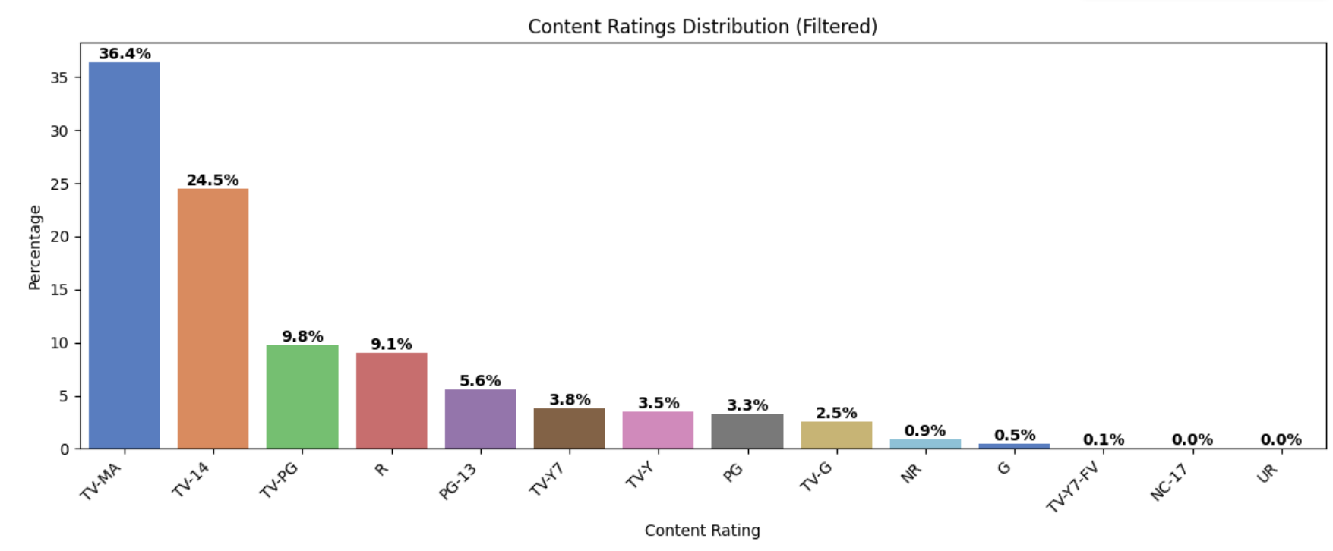
Movie Ratings
36.4% of the content is rated for mature audiences (TV-MA).
Notes:
By offering content with varying ratings, netflix empowers viewers to choose content that aligns with their values and interests, fostering a diverse and inclusive streaming community regardless of age or background, to provide a unique and enriching entertainment experience for all.

Slide 6
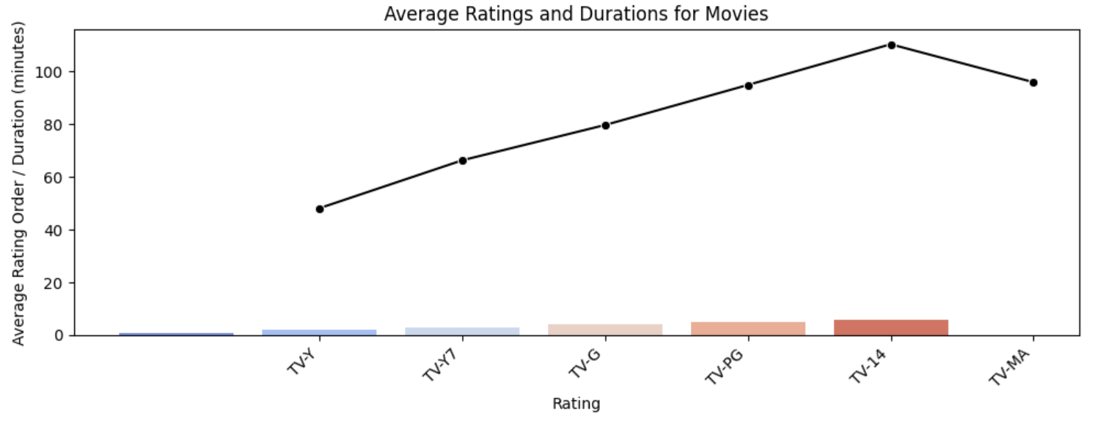
Movie Duration
Movies on Netflix have durations ranging from 45 minutes to 110 minutes.
Highest movie duration is rated TV-14.
Notes:
Younger age groups prefer shorter movie durations, while older age groups tend to enjoy longer and more immersive films.
- this can help Netflix to tailor content recommendations based on age groups, providing personalized streaming experiences that resonate with each viewer's preferences and interests.

Slide 7
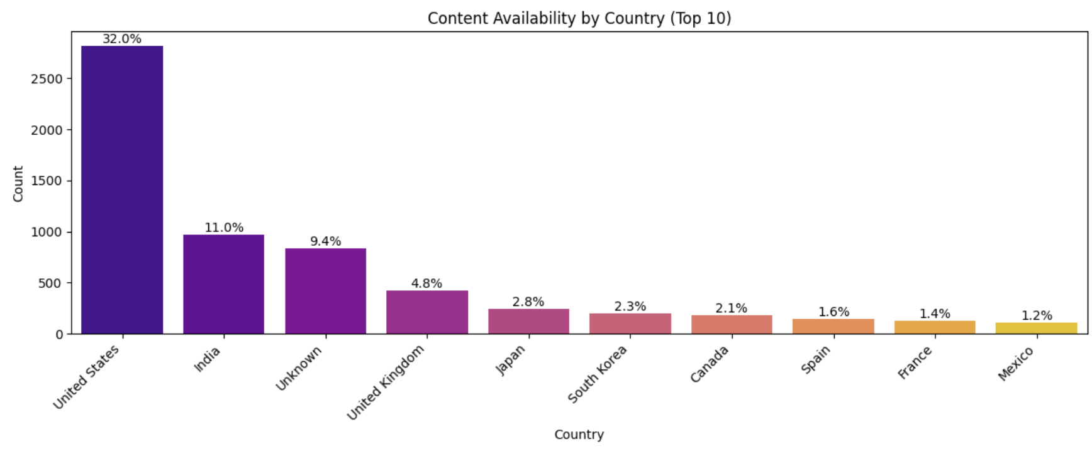
Top Movie Types
The top movie types on Netflix include:
International Movies
Dramas
Comedies
32.0% of movies belong to United States.
Notes:
Netflix offers a content library that caters to the diverse preferences of there subscribers.
-With a vast array of types to explore, netflix empowers viewers to find content that resonates with them, fostering a deep emotional connection and an unforgettable streaming experience.

Slide 8
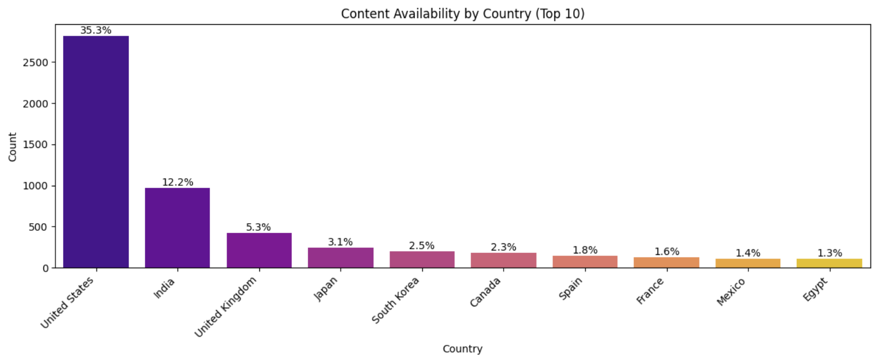
Content Availability by Country
largest Netflix content library:
United States - 35.3%.
India - 12.2%.
United Kingdom - 5.3%.

Slide 9
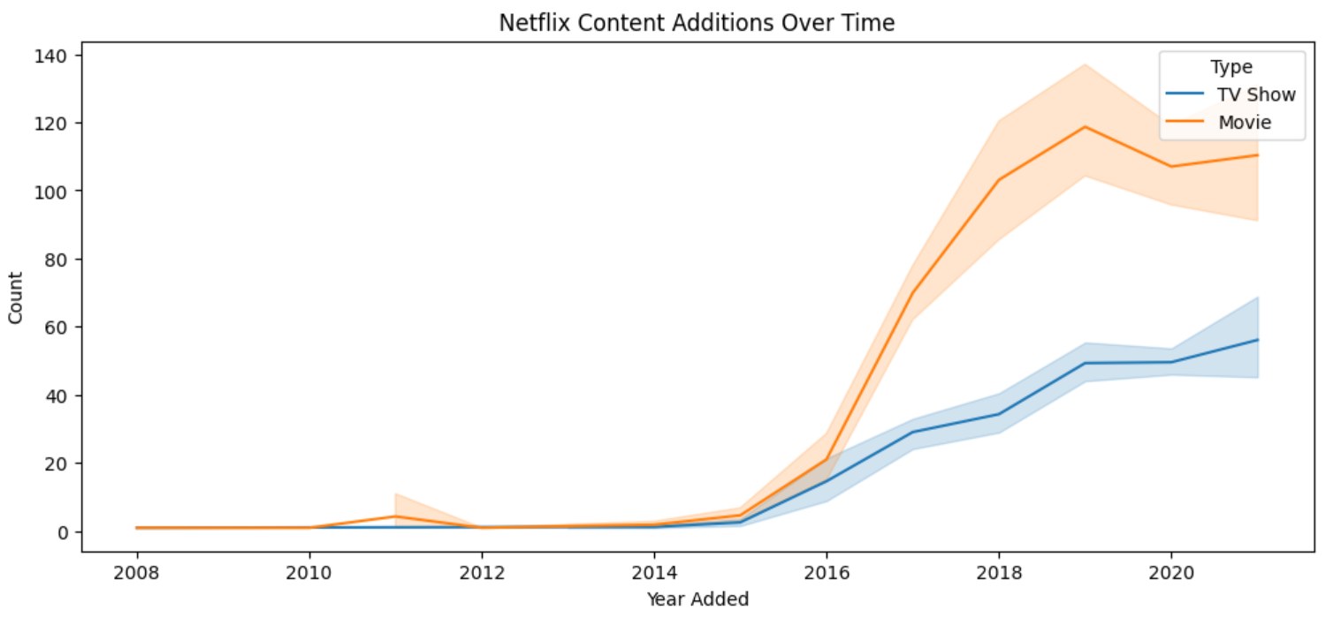
Added Content Over Time
Steady growth since 2015.
Highest growth rate between 2015 - 2019.
Highest growth rate occurred between 2015 - 2019.
Slight drop in 2019.

Slide 10
Conclusion
69.6% of content is movies.
Family-friendly to mature content ratings.
Younger audiences favor shorter films.
International Movies, Dramas, and Comedies are highly viewed worldwide.
United States, India, and United Kingdom boast the largest Netflix content libraries.
Strategic content expansion between 2015-2019.

Slide 11
Recommendations
Continue to prioritize movies content.
Customize movie durations by age groups.
Focus on Popular Movie Types.
Ensure content balance for all audiences.
Invest in original content aligned with viewer preferences.
Notes:
1.Continue to prioritize movies in content acquisition, as they dominate the platform with a 69.6% share. 2. Customize movie durations by age groups. Leverage viewer age group preferences to provide personalized content suggestions. 3. Focus on Popular Movie Types. Strengthen the selection of International Movies, Dramas, and Comedies, as they have widespread appeal. - also, Introduce new and high-quality content in these movie types to captivate audiences globally. 4. Ensure content balance for all audiences. Maintain a balance between family-friendly and mature content: - also, Continue offering a range of content ratings, catering to diverse audience preferences to foster an inclusive streaming community. 5. Invest in original content productions aligned with popular movie types and viewer preferences. - -also, Original productions bolster Netflix's brand identity and enrich the content library

Slide 12

Thank
You
Any Questions?

